Slide 1
CSC1003 Practice 8
Performance

Slide 2
Brief Review
What is performance?
The essence: the efficiency of a program in using computational resources
The two most critical resources are time and space(memory).

Slide 3
Brief Review
The way to predict the performance of a program:
While doubling the input size N, record the running time.
Find the cost and the frequency of execution of each operation. And the total running time is sum of cost × frequency for all operations(by Knuth). We always use only the fastest-growing term to simplify the calculations.

Slide 4
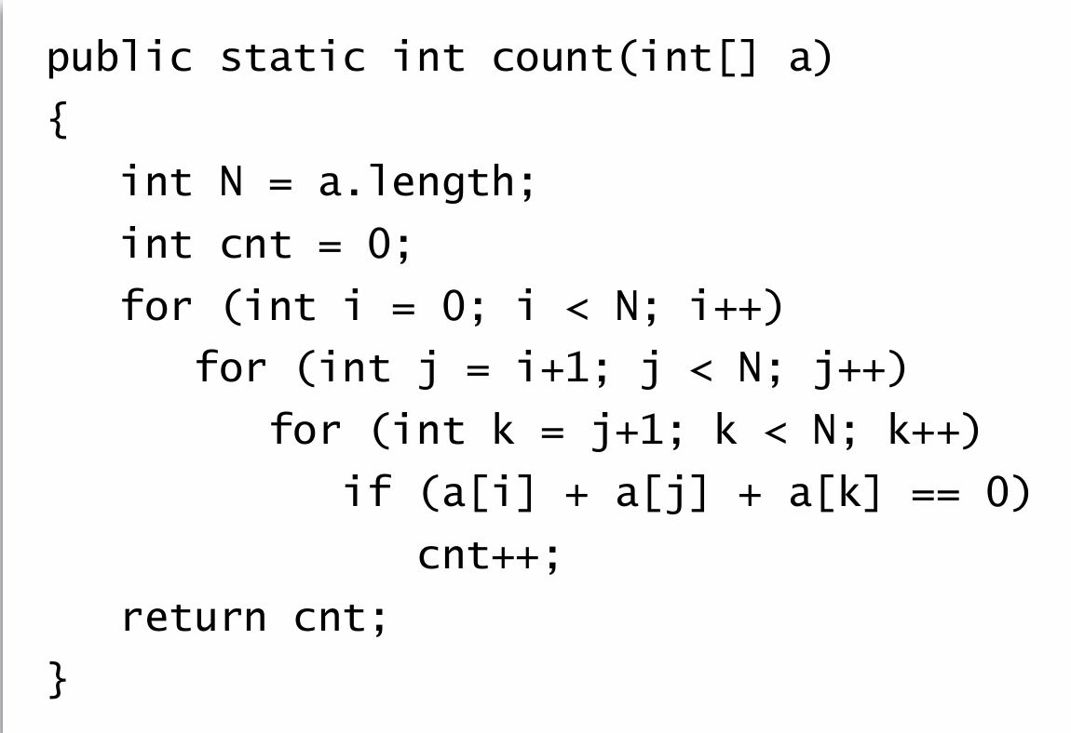
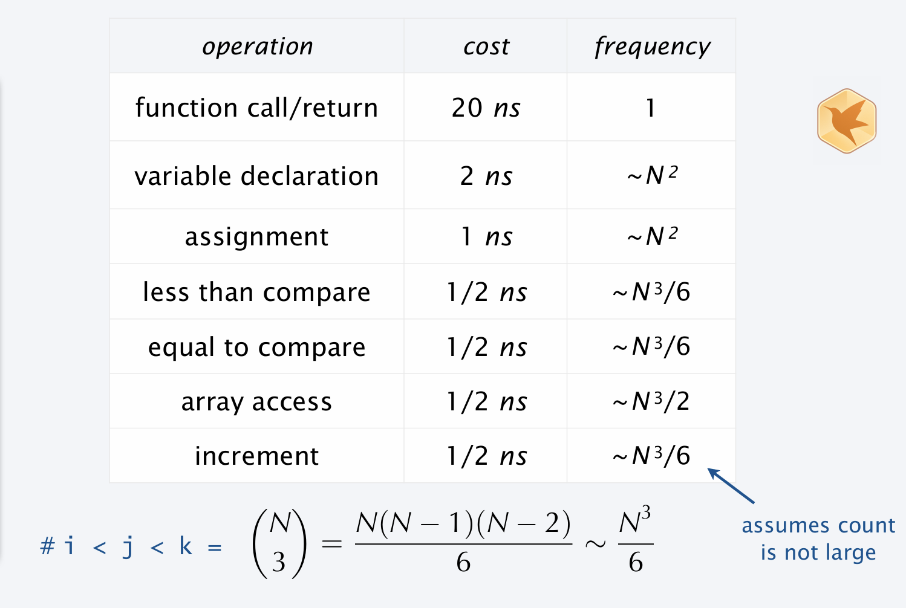
Brief Review
Using Knuth's method, we can determine that the time complexity is O(n³).

Slide 5
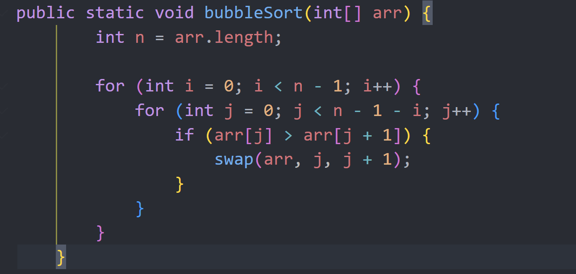
Practice A
Analyze the time complexity of the following program.

Slide 6
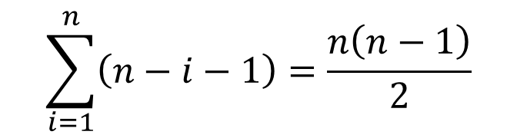
Practice A
$$\sum_{i=1}^{n}{\left(n−ⅈ−1\right)}=\frac{n\left(n−1\right)}{2}$$
We can find the complexity of the program is ${O(n}^{2})$

Slide 7
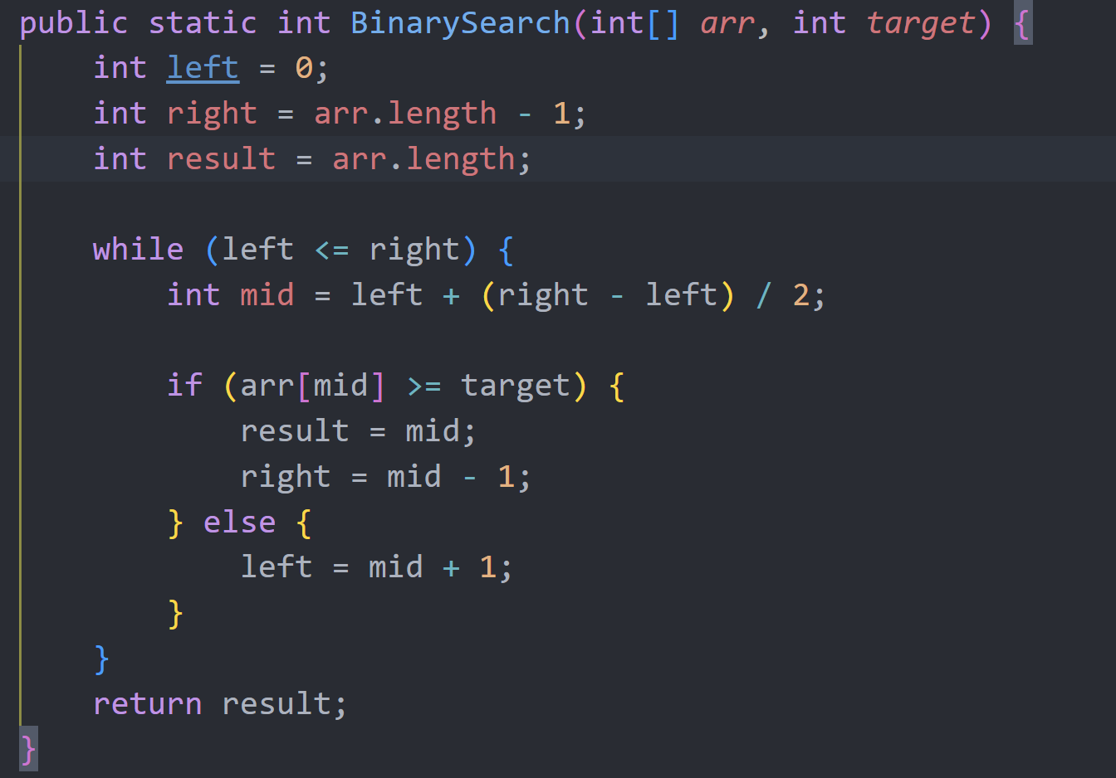
Practice B
Tips: consider the length(right-left+1)

Slide 8

Practice B
We can observe that the length is halved each time.
$O\left(n\right)=O\left(\frac{n}{2}\right)+O\left(1\right)$
Therefore, the time complexity of this program is $O\left(\log{n}\right)$

Slide 9
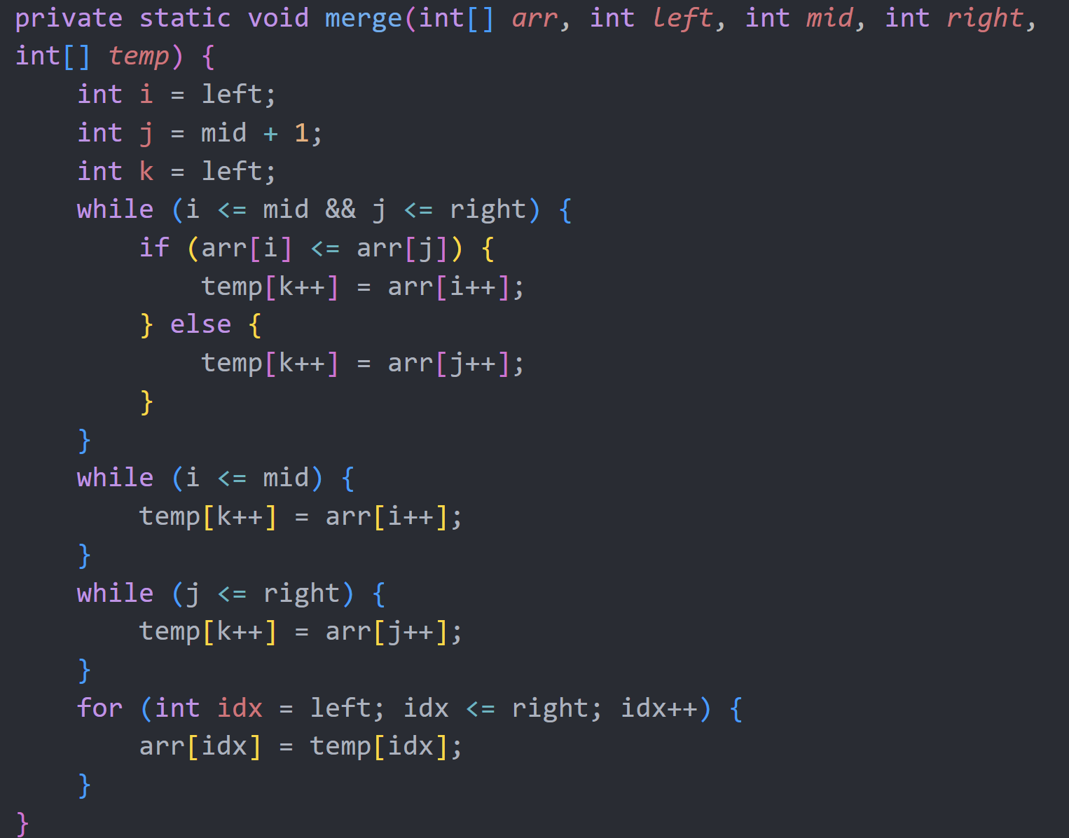
Extra practice
We define n as right - left + 1.
Tips: Consider the final values of i and j.

Slide 10
Extra practice
We can see that the final value of i is mid + 1 and the final value of j is right + 1. Furthermore, in every iteration except the last one, either i or j is incremented by 1.
So the complexity is O(mid + 1 – left + right + 1 – (mid + 1) + right – left + 1) = O(n).

Slide 11
Q&A

